Slide 1
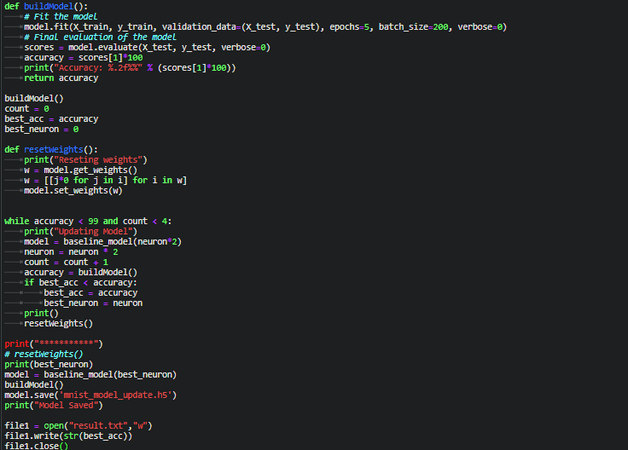
}
Reset the model weights
}
Check if accuracy is less than 99% or count<4. It will increase the neurons and build model again.
}
Save the MODEL with maximum accuracy

Slide 3
}
Reset the model weights
Save the MODEL with maximum accuracy
Check if accuracy is less than 99% or count<4. It will increase the neurons and build model again.

